Slide 1
Misleading Graphs

Slide 2
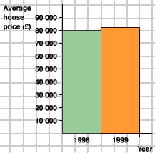
www.mrhammond.org/math/mathlessons/7-8.ppt
Notes:
The scale moves from 0 to 80,000 in the same amount of space as 80,000 to 81,000.
The graph shows the second bar as being 3 times the size of the first bar, which implies a 300% increase in price.
The actual increase in price is 2,000 pounds, which is less than a 3% increase.

Slide 3
Notes:
The difference in percentage points between Democrats and Republicans (and between Democrats and Independents) is 8% (62 – 54). Since the margin of error is 7%, it is likely that there is even less of a difference.
The graph implies that the Democrats were 8 times more likely to agree with the decision. In truth, they were only slightly more likely to agree with the decision.

Slide 5
http://flowingdata.com/2010/05/26/bp-tries-to-mislead-you-with-graphs/

Slide 7
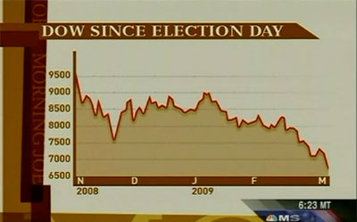

Slide 8
http://mediamatters.org/research/200903070004

Slide 10
http://leftoutside.wordpress.com/2010/06/23/class-war-and-misleading-graphs-from-conservativehome/

Slide 11
‘The data from India is not all of India: it comes from the poor parts of Udaipur district, a rural district in Rajasthan. That’s the one data set that was collected by us, actually.’
http://www.theindiasite.com/the-economist-publishes-misleading-graph-suggesting-94-percent-of-indians-live-on-less-than-2-a-day/

